Slide 1

Modules Summary Discussion – Q&A
CR 3.1
Private and Confidential

Slide 2

Mouth – Teeth and Tongue
1
Copyright: iCare Life Pte. Ltd., Singapore : This document must not be copied or shared or circulated without the consent of iCare Life and/or its affiliates.

Slide 3
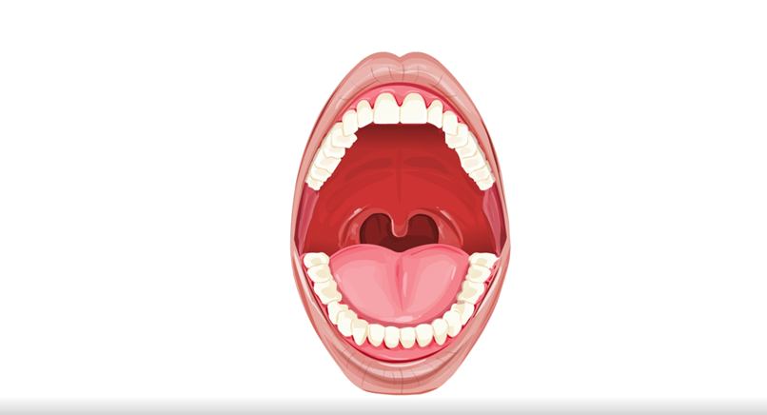
Mouth – Teeth and Tongue
2
Copyright: iCare Life Pte. Ltd., Singapore : This document must not be copied or shared or circulated without the consent of iCare Life and/or its affiliates.

Slide 4
Summary
An adult has 32 permanent teeth. In each quadrant, there are:
2 incisors
1 canine
The visible part of the tooth is the crown and the part embedded in the jaw is the root
The gum helps attach the tooth to the jaw
The parts of a tooth are:
Enamel
Dentine
Cementum
The tongue is attached at the back to hyoid bone in the throat and at the bottom of mouth by frenulum
2 premolars
3 molars
Pulp
Nerves and blood
3
Copyright: iCare Life Pte. Ltd., Singapore : This document must not be copied or shared or circulated without the consent of iCare Life and/or its affiliates.
Notes:
An adult has 32 permanent teeth. In each quadrant, there are:
2 incisors - with thin flat surface used for biting and cutting food
1 canine – with pointed tip used for biting and cutting
1 premolars – with broad flat surface used chewing, crushing and grinding with molars
3 molars – with broad flat surface used chewing, crushing and grinding with pre molars
The visible part of the tooth is the crown and the part embedded in the jaw is the root
The gum helps attach the tooth to the jaw
The parts of a tooth are:
Enamel – smooth layer strong and smooth outer layer of the tooth
Dentine - layer under enamel which supports the enamel and absorbs the pressure on teeth when we bite, chew or grind
Cementum - bone-like tissue covering the root which helps to attach the tooth to the bones in your jaw.
Pulp - center of the tooth
Nerves and blood supply – are within the nerve

Slide 5
Summary
Small bumps called papillae on tongue contain taste buds with hair cells, nerves and blood supply
Each taste bud can detect four tastes, which are sweet, sour, salty and bitter
The following process describes how we can taste food:
The hair on the taste buds detect the taste
It sends signals to the nerves
The nerves transmit the signal to the brain
The brain interprets the signals and we taste a food or drink
4
Copyright: iCare Life Pte. Ltd., Singapore : This document must not be copied or shared or circulated without the consent of iCare Life and/or its affiliates.
Notes:
An adult has 32 permanent teeth. In each quadrant, there are:
2 incisors - with thin flat surface used for biting and cutting food
1 canine – with pointed tip used for biting and cutting
1 premolars – with broad flat surface used chewing, crushing and grinding with molars
3 molars – with broad flat surface used chewing, crushing and grinding with pre molars
The visible part of the tooth is the crown and the part embedded in the jaw is the root
The gum helps attach the tooth to the jaw
The parts of a tooth are:
Enamel – smooth layer strong and smooth outer layer of the tooth
Dentine - layer under enamel which supports the enamel and absorbs the pressure on teeth when we bite, chew or grind
Cementum - bone-like tissue covering the root which helps to attach the tooth to the bones in your jaw.
Pulp - center of the tooth
Nerves and blood supply – are within the nerve

Slide 6
Summary
The tongue is attached at the back to hyoid bone in the throat and at the bottom of mouth by frenulum
Small bumps called papillae on tongue contain taste buds with hair cells, nerves and blood supply
Each taste bud can detect four tastes, which are sweet, sour, salty and bitter
The following process describes how we can taste food:
The hair on the taste buds detect the taste
It sends signals to the nerves
The nerves transmit the signal to the brain
The brain interprets the signals and we taste a food or drink
5
Copyright: iCare Life Pte. Ltd., Singapore : This document must not be copied or shared or circulated without the consent of iCare Life and/or its affiliates.
Notes:
The tongue is attached at the back to hyoid bone in the throat and at the bottom of mouth by frenulum
Small bumps called papillae on tongue contain taste buds with hair cells, nerves and blood supply
Each taste bud can detect four tastes, which are sweet, sour, salty and bitter
The following process describes how we can taste food:
The hair on the taste buds detect the taste
It sends signals to the nerves
The nerves transmit the signal to the brain
The brain interprets the signals and we taste a food or drink

Slide 7
Any Questions?
6
Copyright: iCare Life Pte. Ltd., Singapore : This document must not be copied or shared or circulated without the consent of iCare Life and/or its affiliates.
Notes:
FAQs:
Question 1: Why do I feel a painful sensation in my teeth when I drink something very hot or cold?
Answer 1: : It is because for one or more tooth, your enamel is damaged and the dentine is exposed to the hot or cold drink. Many nerves touch dentine and send instant signals to the brain.
Question 2: Are taste buds on different parts of the tongue more sensitive to a particular taste?
Answer 2: This is a misconception. Taste buds on all parts of the tongue are equally sensitive to different tastes.
Question 3: After eating an ice cube, salty food seems to be less salty. Why is it so?
Answer 3: Some things can make your taste bud receptors less sensitive, like cold foods or drinks because they numb the nerves.
Question 4: Does the tongue ever rest?
Answer 4: Tongue never rests. Even when we are sleeping, our tongue keeps pushing the saliva into the throat to be swallowed.

Slide 8
Skin, Hair, and Nails
7
Copyright: iCare Life Pte. Ltd., Singapore : This document must not be copied or shared or circulated without the consent of iCare Life and/or its affiliates.

Slide 9
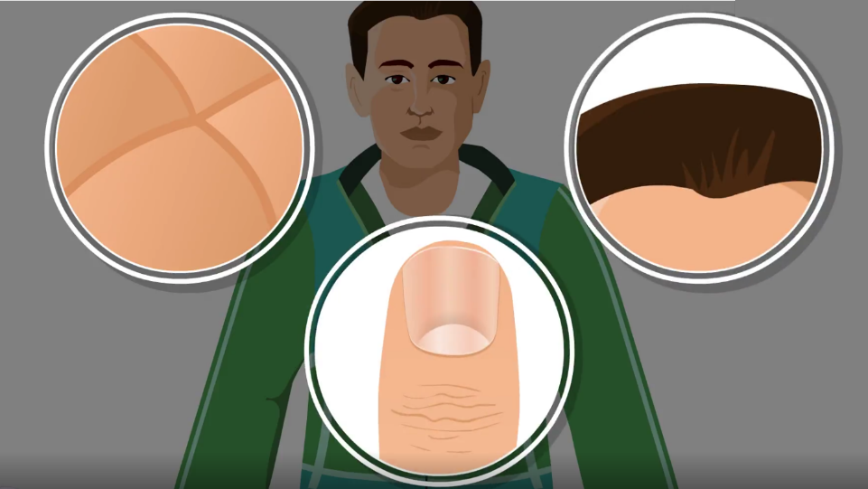
Skin, Hair, and Nails
8
Copyright: iCare Life Pte. Ltd., Singapore : This document must not be copied or shared or circulated without the consent of iCare Life and/or its affiliates.

Slide 10
Summary
Our skin:
Covers and protects the structure inside the body
Helps us feel what we touch
Helps get rid of waste
Helps regulate our body temperature
The three layers of skin are:
Epidermis
Dermis
Subcutaneous layer
The receptors in the skin detect what we touch and send signals to the brain through the spinal cord
9
Copyright: iCare Life Pte. Ltd., Singapore : This document must not be copied or shared or circulated without the consent of iCare Life and/or its affiliates.
Notes:
Our skin:
Covers and protects the structure inside the body,
Helps us feel what we touch,
Helps get rid of waste, and
Helps regulate our body temperature
The three layers of skin are:
Epidermis with melanocytes, keratinocytes, and langerhans
Dermis with connective tissues, subcutaneous gland, sweat gland, hair shaft, blood vessels, and nerves
Subcutaneous layer with fat, nerves, blood vessels, and papilla

Slide 11
Summary
The hair:
Protects the skin, nose, ears, and eyes
And keeps the skin warm
The main parts of a hair are:
Papilla
Follicle
And hair shaft
The process of hair growth is as follows:
The hair cells at the papilla divide and form new hair cells
The old cells move upward and are cut from the blood supply
These dead cells are converted to keratin
10
Copyright: iCare Life Pte. Ltd., Singapore : This document must not be copied or shared or circulated without the consent of iCare Life and/or its affiliates.

Slide 12
Summary
Our nails:
Protect the tips of fingers and toes
And help in scratching and picking objects
The process of nail growth is as follows:
The epidermal cells below the matrix divide to form new cells
The old cells move up and are cut from the blood supply
As more cells are generated, the nail is pushed forward and the nail grows longer
11
Copyright: iCare Life Pte. Ltd., Singapore : This document must not be copied or shared or circulated without the consent of iCare Life and/or its affiliates.

Slide 13
Any Questions?
12
Copyright: iCare Life Pte. Ltd., Singapore : This document must not be copied or shared or circulated without the consent of iCare Life and/or its affiliates.
Notes:
FAQs:
Question 1: Why do we get wrinkles as we age?
Answer 1: As we age the elastin in our skin degenerates, due to which the elasticity of skin decreases and the skin is not able to get back to its original shape.
Question 2: Why do teenagers get more pimples and acne?
Answer 2: A teenager's body generates certain hormones in much more quantity than others. These hormones increase the production of sebum in the sebaceous glands. When too much oil is secreted, the pores in the skin are clogged and inflamed, which causes pimples and acne.
Question 3: Why do people become bald?
Answer 3: A person becomes bald if the follicles in the scalp become inactive and do not produce new hair.
Question 4: Do we get goosebumps because of the erector pilli muscle pulling the hair?
Answer 4: Indeed, the erector pilli muscle contracts to make the hairs on our skin stand up straight and we can see the goosebumps. This happens when we are cold or frightened.
Question 5: What are the white spots on nails we see at times? Answer 5: If there was a temporary change in the growth or the nail was hurt while that part of nail was in the matrix, you can see the white spots.

Slide 14
Ear and Hearing
13
Copyright: iCare Life Pte. Ltd., Singapore : This document must not be copied or shared or circulated without the consent of iCare Life and/or its affiliates.

Slide 15
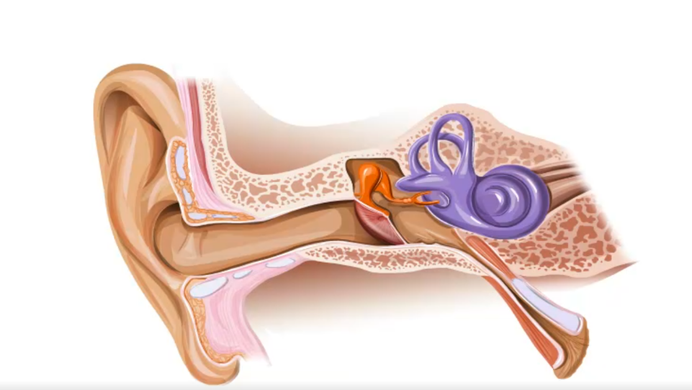
Ear and Hearing
14
Copyright: iCare Life Pte. Ltd., Singapore : This document must not be copied or shared or circulated without the consent of iCare Life and/or its affiliates.

Slide 16
Summary
The structure of ear can be divided into:
Outer ear with pinna and external auditory canal
Middle ear with the eardrum, auditory ossicles, and the Eustachian tube
Inner ear with cochlea, vestibule, and the three semicircular canals
The following process describes how we hear:
The external ear directs sound waves to the eardrum
The eardrum vibrates and transfers the vibrations to the auditory ossicles
The auditory ossicles transfer the vibrations to the cochlea
The fluid inside cochlea moves
The hair cells move and send signals to the brain
The brain interprets the signals and we hear the sound
The vestibule helps the brain understand any linear movement of the head
The semicircular canals help the brain understand any movement if head moves at an angle
15
Copyright: iCare Life Pte. Ltd., Singapore : This document must not be copied or shared or circulated without the consent of iCare Life and/or its affiliates.
Notes:
Eyes are located inside the eye socket.
Sclera covers and protects the eyes.
Light enters the eye through pupil.
Muscles in the iris help the pupil to change shape.
Conjunctiva produces mucous, which lubricates and protects the eyes and eyelids.
Cornea located above the iris and pupil helps make the vision clearer.

Slide 17
Any Questions?
16
Copyright: iCare Life Pte. Ltd., Singapore : This document must not be copied or shared or circulated without the consent of iCare Life and/or its affiliates.
Notes:
FAQs:
Question 1: When an airplane lands we feel a pop in our ear. Is it because the Eustachian tube opens?
Answer 1: Changing altitude, which means going up or down, suddenly affects the pressure of air in our ears. At this time, the Eustachian tube opens to make sure that the air pressure is same on both sides of the eardrum and we feel a plop.
Question 2: Are semicircular canals responsible for our feeling dizzy after taking a ride in an amusement park?
Answer 2: When you step off a ride in an amusement park, the fluid in your semicircular canals is still moving and the hairs cells inside the canals still sense movement even though you are standing still. Your brain is confused about the position of your head and sends confusing signals to the muscles. Therefore, you feel dizzy. When the fluid in the semicircular canals stops moving, the brain gets and sends the right signals and you regain your balance.
Question 3: Can a loud sound hurt ears?
Answer 3: Temporary hearing loss can happen after you've been exposed to loud noise for short duration.
Question 4: Can the eardrum tear?
Answer 4: Infections, poking the ear, sudden air pressure changes, very loud music, or head injuries can cause the eardrum to rupture.

Slide 18
Eye and Vision
17
Copyright: iCare Life Pte. Ltd., Singapore : This document must not be copied or shared or circulated without the consent of iCare Life and/or its affiliates.

Slide 19
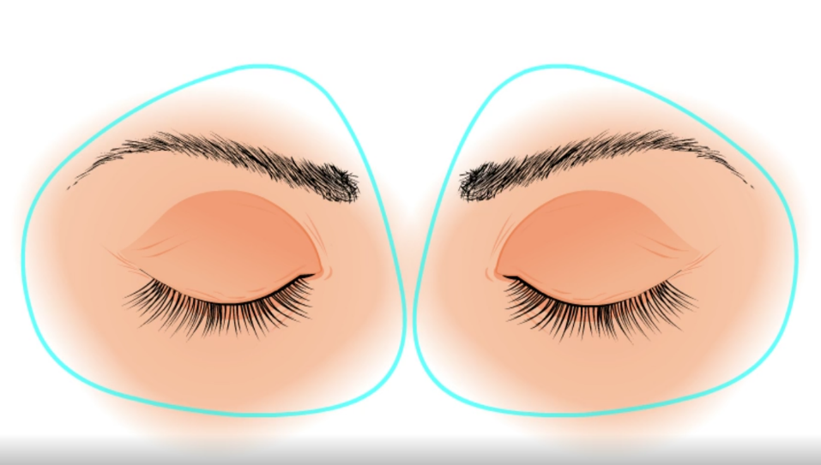
Eye and Vision
18
Copyright: iCare Life Pte. Ltd., Singapore : This document must not be copied or shared or circulated without the consent of iCare Life and/or its affiliates.

Slide 20
Summary
Eyes are located inside the eye socket
Sclera covers and protects the eyes
Light enters the eye through pupil
Muscles in the iris help the pupil to change shape
Conjunctiva produces mucous, which lubricates and protects the eyes and eyelids
Cornea helps make the vision clearer
Lens and the ciliary muscles help the eye focus on objects
Aqueous humor in anterior chamber nourishes the eye and keeps it healthy
Vitreous humor in vitreous chamber gives the round shape to the eyes
19
Copyright: iCare Life Pte. Ltd., Singapore : This document must not be copied or shared or circulated without the consent of iCare Life and/or its affiliates.
Notes:
Eyes are located inside the eye socket
Sclera covers and protects the eyes
Light enters the eye through pupil
Muscles in the iris help the pupil to change shape
Conjunctiva produces mucous, which lubricates and protects the eyes and eyelids
Cornea helps make the vision clearer – cornea is located above the iris and pupil
Lens and the ciliary muscles help the eye focus on objects
Aqueous humor in anterior chamber nourishes the eye and keeps it healthy
Vitreous humor in vitreous chamber gives the round shape to the eyes

Slide 21
Summary
A clear image can be seen when the reflected light from an object strikes the macula
The following process describes how we see objects:
When light reflects from an object, the cornea bends the light rays before they enter the eye through the pupil
The light ray strikes the retina
The rods and cones in the retina convert the light into signals
The optic nerve transmits the signals to the brain
The brain interprets the image, enabling us to see the object
20
Copyright: iCare Life Pte. Ltd., Singapore : This document must not be copied or shared or circulated without the consent of iCare Life and/or its affiliates.
Notes:
A clear image can be seen when the reflected light from an object strikes the macula - Our vision is the sharpest when the light reflected from an object strikes fovea
The following process describes how we see objects:
When light reflects from an object, the cornea bends the light rays before they enter the eye through the pupil
The light ray strikes the retina
The rods and cones in the retina convert the light into signals
The optic nerve transmits the signals to the brain
The brain interprets the image, enabling us to see the object

Slide 22
Any Questions?
21
Copyright: iCare Life Pte. Ltd., Singapore : This document must not be copied or shared or circulated without the consent of iCare Life and/or its affiliates.
Notes:
FAQs:
Question 1: How do we get tears in the eyes?
Answer 1: : Lacrymal glands are placed above both the eyes, which produce tears and drain the tears into the eyes.
Question 2: How are we able to see in dim light?
Answer 2: Rods are cells that are highly sensitive to light and help us see in dim light.
Question 3: Why do we need bright light to see colours clearly?
Answer 3: The cones are less sensitive than rods, therefore, we need good lighting for colour vision.
Question 4: Is conjunctivitis related to problems with conjunctiva?
Answer 4: Yes, conjunctivitis is the inflammation of conjunctiva. Conjunctivitis makes the eye and lids appear red.

Slide 23
The Nervous System
22
Copyright: iCare Life Pte. Ltd., Singapore : This document must not be copied or shared or circulated without the consent of iCare Life and/or its affiliates.

Slide 24
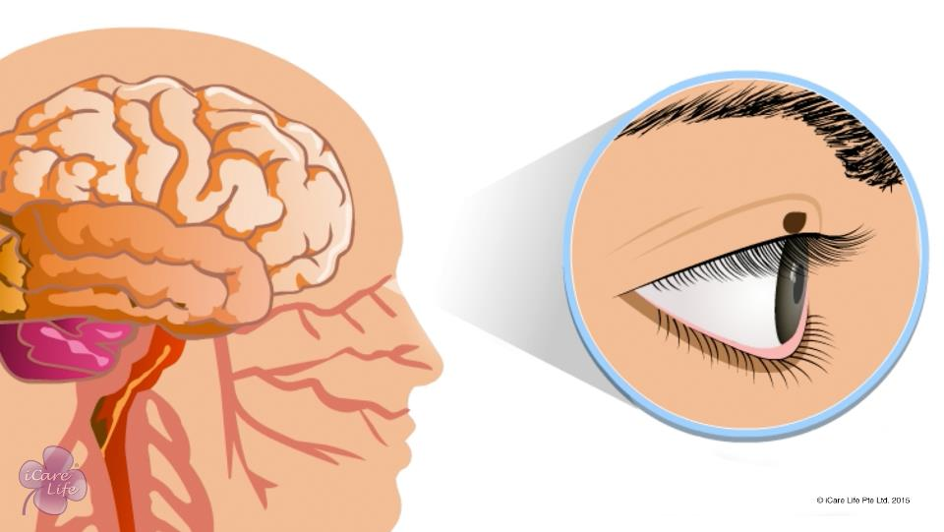
The Nervous System
23
Copyright: iCare Life Pte. Ltd., Singapore : This document must not be copied or shared or circulated without the consent of iCare Life and/or its affiliates.

Slide 25
Summary
The nervous system consists of:
Brain
Spinal cord
Nerves
The nervous system is made up of millions of neurons connected together
The nervous system can be divided into:
The central nervous system with brain and spinal cord
The peripheral nervous system with nerves
The parts of the brain are:
Cerebrum, which controls the sense organs, movement, speech, learning, imagination, intelligence, and memory
Cerebellum, which controls the movements of the muscles
Brain stem, which controls the autonomic actions
24
Copyright: iCare Life Pte. Ltd., Singapore : This document must not be copied or shared or circulated without the consent of iCare Life and/or its affiliates.

Slide 26
Summary
The brain is connected to the spinal cord and cranial nerves
The spinal cord is attached to the brain and 31 spinal nerves
The peripheral nervous system can be divided into:
The somatic nervous system involved in conscious actions
The autonomic nervous system involved in autonomic actions
Brain controls and coordinates all the conscious actions in the body
Spinal cord controls and coordinates some of the autonomic actions
25
Copyright: iCare Life Pte. Ltd., Singapore : This document must not be copied or shared or circulated without the consent of iCare Life and/or its affiliates.

Slide 27
Any Questions?
26
Copyright: iCare Life Pte. Ltd., Singapore : This document must not be copied or shared or circulated without the consent of iCare Life and/or its affiliates.
Notes:
FAQs:
Question 1: Are neurons produced in brain?
Answer 1: We are born with a certain number of neurons. As we grow the neurons become bigger and create many synaptic connections. With age, some of the neurons in our brain die.
Question 2: When do neurons start dying?
Answer 2: Around the age of 20, we begin to lose neurons and by the age of 75, nearly one-tenth of the neurons we were born with are dead.
Question 3: What happens when neurons die?
Answer 3: When neurons die the brain becomes a little less functional.
Question 4: How do we learn things and get better with practice?
Answer 4: When we learn new things, our brain has to think how to do each and every task. As we practice, the neurons in the brain send messages back and forth and a pathway is created in the brain for that particular task. When this happens , we can do things without much effort.
Question 5: Is meningitis related to meninges?
Answer 5: Meningitis is inflammation of meninges cause by bacteria or viruses, but some can also be due to certain medications or illnesses.

Slide 28


